Slide 1
Data Collections – Getting Started
GaDOE Data Collections Conference
August 2011

Slide 2
Start GaDOE Data Transmission Dates
http://public.doe.k12.ga.us
http://public.doe.k12.ga.us

Slide 3
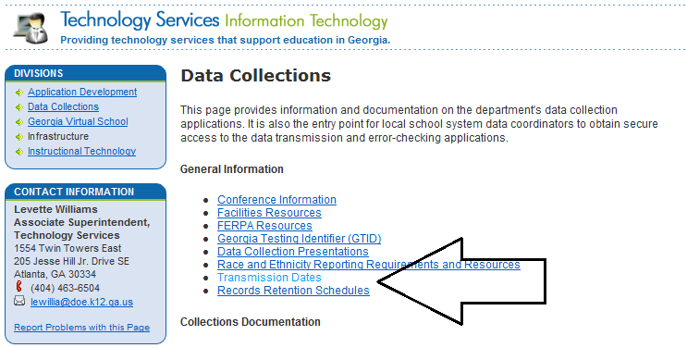
Select Transmission Dates

Slide 4
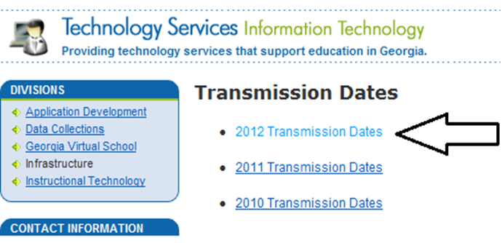
Select Current Year

Slide 5
Sample Calendar
Month | Task
June | Apply for facility code for any new schools
August | Summer Graduates
 | Pre-ID Labels
 | GTID-New Students
 | GTID-All Students
 | Course Profile
 | HOPE Summer Graduates
 | HOPE Underclassmen
September | FTE Data Survey
October | FTE-1
 | CPI
 | Class Size

Slide 6
Sample Calendar (cont’d)
Month | Task
November | Pre-ID 2
 | Free/Reduced Meal
 | Private School/ Home School
February | HOPE Scholarship Preliminary
 | Pre-ID 3
March | FTE 3
 | CPI 2
 | Class Size 2
June | HOPE Scholarship Final
 | Student Record
July | CPI 3
 | HOPE Underclassmen 2

Slide 7
Build Your Own Processing Calendar
Start with GaDOE Calendar. Input not only deadlines, but also starting dates and milestones
Determine key types of data submitted for each cycle and build in processes to review data.
Beginning of year – reminder that SSN, date of birth, race, are all necessary for initial GTID claim. Schools will call in panic trying to test a student and want you to expedite getting the GTID.

Slide 8
Incorporate Local Processes
Include Grade Processing Schedules
Include local testing cycles
Include vacations, school breaks, etc.
Publish one calendar that shows all processing cycles
Schedule workshops before school starts and before major data processing cycles

Slide 9
Data Tips - GTID
To begin school year, review data to ensure SSN, date of birth, race, gender. Any of these data elements will cause no match in GTID
Try not to claim GTID until No Shows are identified.
Kindergarten students will not be able to be tested until GTID is claimed.
Most testing software now requires GTID, so this needs to be the first order of business.

Slide 10
Data Tips – After GTID
After GTID are claimed, start submitting Student Course Profile
For each FTE cycle, offer workshops for schools to assist each other, and for clerks to get away from schools and input data.
Before submitting Pre-ID, it is important that special identifiers such as ELL, Special Ed., Gifted, etc. are correct.

Slide 11
Data Tips - Ongoing
Have high schools verify SSN’s early in the school year. Students without a “real” SSN do not receive HOPE.
Develop a master course file that identifies FTE codes, and CPI codes.
Bookmark http://public.doe.k12.ga.us/pea_board.aspx?PageReq=PEABoardRules
Be sure to make first data submission for FTE, Student Record, and CPI as early as possible, but at least by the Initial Submission deadline.

Slide 12
Where to Get Help
Network!
Don’t leave this conference without a list of contacts you can call on
SIS GaDOE Sub-Committee
Usually meets the last Wednesday of every-other month
All are welcome
Not only do you learn a lot from these calls, but your input counts!
CIO Conference calls

Slide 13
Conferences and Workshops
Data Collections Conference in August
Learn what is required by the state
GSIS Conference in early February – www.gsisusers.org
Although the state has a presence at this conference, it is run by users like yourself. You pick the topics and your colleagues present the sessions (you can too!)
GaETC Conference in November – www.gaetc.org
Good way to see technology innovation, lots of vendors, sessions on a wide range of topics

Slide 14
What do you do all summer???
Student Record
HOPE Scholarship
Prepare to start the new year
ENDLESS CYCLE!

